Slide 1
SYMPTOMLOG
Why SymptomLog, and what it must achieve
THE CORE PROBLEM
THE ENGINEERING GOAL
Patients forget crucial symptom context before clinical visits; unstructured notes prevent timely pattern discovery.
Deliver a structured platform for logging, multi-tier safety triage, trend analysis, and secure multi-role sharing.
SYMPTOMLOG | ANUBHAV CHOUDHARY (24BYB1090)
Notes:
Introduce the project: SymptomLog addresses the clinical gap between onset of symptoms and formal consultation.
Emphasize software quality, privacy, and clinical communication.

Slide 2
From scattered memory to a structured, connected system
CURRENT CLINICAL REPORTING CHALLENGES MAPPED DIRECTLY TO ARCHITECTURAL CAPABILITIES
Current challenge | Required capability
Memory-based reporting | Structured, longitudinal log preserving timestamped context
No pattern visibility | Multi-dimensional filters and longitudinal severity trends
Unclear when to seek care | Four-tier deterministic triage engine with specialist suggestion
Missed medication doses | Two-layer alarm scheduler backed by an immutable adherence record
Vague doctor visits | One-click printable clinical summary, linked appointments, and physician notes
SYMPTOMLOG | ANUBHAV CHOUDHARY (24BYB1090)
02 / 11
Notes:
Walk through the direct transition from user pain points to concrete engineering features.

Slide 3
Twelve modules, each with one clear job
Authentication and Sessions: secure login and token rotation
Symptom Logging: plain-language entry with NLP assistant
Disease Prediction: ranks likely conditions with confidence scores; advisory only, never a diagnosis
Triage Engine: four-tier, rule-based classification
History and Trends: filters and severity charts
Medication Alarms: reminders and adherence record
Appointments: book with a physician, linked to entries
Clinical Summary: printable report for a date range
Caregiver Sharing: time-limited read-only links
Feedback: rate each triage result
Physician Portal: review history and add notes
Administrator Portal: manage physicians and retrain model
SYMPTOMLOG | ANUBHAV CHOUDHARY (24BYB1090)
03 / 11
Notes:
Present the modular boundary of the platform. Each box represents an encapsulated service domain.

Slide 4
Three independent services, one data layer
SERVICE-ORIENTED BOUNDARY DESIGN WITH RESILIENT ISOLATION AND GRACEFUL DEGRADATION
LAYER 01 · CLIENT
React 19 & Vite: Dedicated workspaces for patients, physicians, and administrators with responsive client state.
Frontend
LAYER 02 · ORCHESTRATION
Node.js & Express: Authentication, JWT rotation, alarm scheduler, clinical PDF compilation, and core workflows.
Backend API
LAYER 03 · INFERENCE
Python 3.11 & FastAPI: Serves NLP extraction and disease classification; isolated with graceful timeout fallback.
ML Microservice
DATA SUBSTRATE
PostgreSQL or SQLite: Unified relational schema managed via declarative, versioned migration scripts.
Data Layer
RESILIENCE · DUAL-MODE DB WITH ZERO-CONFIG EMBEDDED FALLBACK
PACKAGING · DOCKER CONTAINERIZED WITH ACTIVE HEALTH PROBES
ISOLATION · CORE API FUNCTIONS UNINTERRUPTED IF ML SERVICE HALTS
SYMPTOMLOG | ANUBHAV CHOUDHARY (24BYB1090)
04 / 11
Notes:
Detail the architectural separation: React client, Node.js gateway, Python inference engine, and portable SQL layer.

Slide 5
Two models for understanding, one engine for safety
PROBABILISTIC MACHINE LEARNING BOUNDED BY STRICT, DETERMINISTIC CLINICAL TRIAGE RULES
STATISTICAL ML LAYER
DETERMINISTIC RULE-BASED TRIAGE
NLP Extractor
Tier | Trigger
Urgent | Chest pain or breathing distress at 7+, severe headache or high fever at 9+, or maximum severity
Chronic Care | Lasting 90+ days or a known chronic condition
Recurring Pattern | Logged 3+ times in 30 days; suggests a specialist
Routine Acute | Under 14 days and isolated; self-care guidance
Parses free-text complaints to extract primary symptoms, anatomical locations, and severity estimates.
Disease Classifier
Evaluates 24 conditions with about 97% holdout accuracy, providing ranked confidence scores.
MEDICAL DISCLAIMER: ADVISORY ONLY, NEVER A CLINICAL DIAGNOSIS. EVERY PREDICTION CARRIES AN EXPLICIT CONFIDENCE SCORE.
SYMPTOMLOG | ANUBHAV CHOUDHARY (24BYB1090)
05 / 11
Notes:
Clarify that AI inference never overrides triage rules: urgent flags trigger deterministic emergency workflows.

Slide 6
Entity Relationship Diagram
RELATIONAL DATABASE TOPOLOGY SUPPORTING LONGITUDINAL TRACKING, CARE CIRCLES, AND CLINICAL AUDIT
CORE RELATIONS
APPOINTMENTS
FEEDBACK
PERSISTENCE
1 Patient has many symptom entries, medications, appointments, and secure share links.
Joins Patient, Physician, and optionally specific Symptom Entries for consultation context.
Each Triage evaluation accepts discrete feedback records to monitor safety outcomes.
One schema, two database modes, versioned migrations.
SYMPTOMLOG | ANUBHAV CHOUDHARY (24BYB1090)
06 / 11
Notes:
Present the primary relational bindings. The framed canvas represents the designated slot for the exported ER diagram.

Slide 7
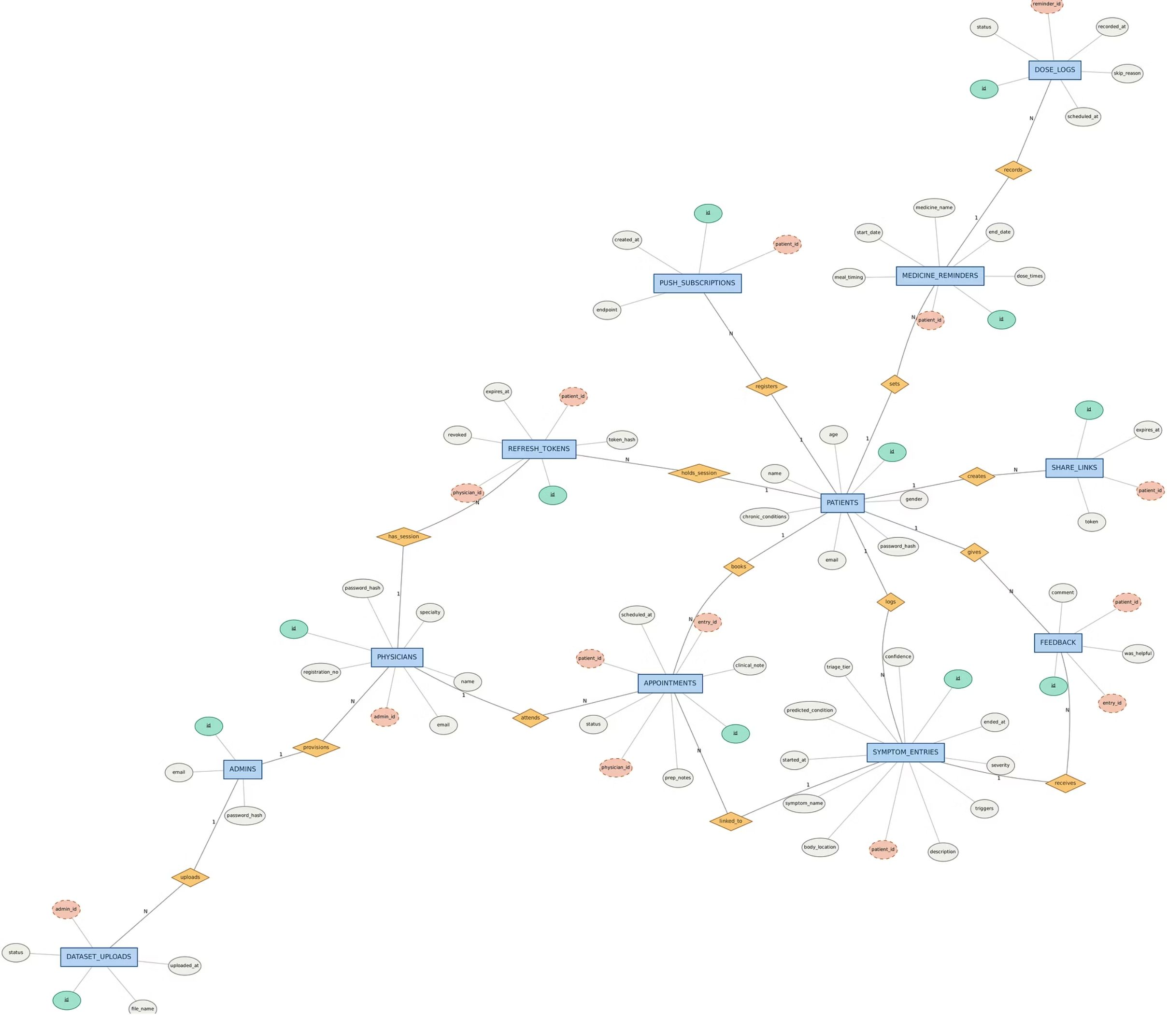

Slide 8
Iterative cycles, mapped to classic design stages
ITERATION CYCLE
CLASSIC DESIGN STAGES
Requirement gathering: define users and needs
Research: datasets and tools
Design and wireframes: test layouts early
Iterative implementation: short sprints
Testing and feedback: validate with users
Refinement: adjust and repeat
Stage | Focus
Planning | Scope and schedule
Requirement analysis | Functional and safety needs
System design | Architecture, modules, UI, ER model
Implementation | Frontend, backend, ML service
Testing | Functional, security, alarm behavior
Deployment | Docker
SYMPTOMLOG | ANUBHAV CHOUDHARY (24BYB1090)
08 / 11
Notes:
Describe how agile iterations map onto classical software engineering stages.

Slide 9
From memory-based notes to a connected record
Before | After
Memory-based reporting | Structured, timestamped history
Scattered notes | Instant triage with specialist suggestion
Missed doses | Background alarms and server-side adherence record
Unsure when to see a doctor | One-click clinical summary
SYMPTOMLOG | ANUBHAV CHOUDHARY (24BYB1090)
09 / 11
Notes:
Review the measurable transformation in patient record completeness and physician diagnostic utility.

Slide 10
VERIFIED SYSTEM PERFORMANCE
Outcomes: a working, secure, portable platform
Multi-Portal Ecosystem
Dual-Model Inference
01
02
Three-service platform with portals for patients, physicians, and administrators.
Two ML models; about 97% holdout accuracy over 24 conditions.
Deterministic Triage Engine
Defense in Depth
03
04
Deterministic, inspectable triage rules.
Hashed passwords, rotating tokens, and rate limiting.
Containerized Portability
05
Containerized, portable deployment.
SYMPTOMLOG | ANUBHAV CHOUDHARY (24BYB1090)
10 / 11
Notes:
Summarize the engineering achievements: multi-role portal, high ML accuracy, deterministic safety, and containerized deployment.

Slide 11
Possible enhancements
FUTURE ROADMAP FOR ENTERPRISE SCALING, EXPANDED INTAKE CHANNELS, AND ADVANCED INTELLIGENCE
ROADMAP 01
ROADMAP 02
ROADMAP 03
Production
Mobile OS
Omnichannel
Deploy with strict TLS/HTTPS, automated CDN edge caching, and fully managed cloud databases.
Engineer native iOS and Android clients with OS-level background alarm workers that trigger when closed.
Add fallback SMS and transactional email reminders for high-risk medication adherence schedules.
ROADMAP 04
ROADMAP 05
ROADMAP 06
Voice Intake
Wearables
LLM Upgrade
Support multilingual natural speech-to-text input to remove logging barriers for elderly and acute patients.
Integrate continuous telemetry streams (heart rate, temperature, SpO2) via Apple HealthKit and Google Health.
Incorporate clinical BERT or modern transformer foundations retrained iteratively on validated feedback loops.
SYMPTOMLOG | ANUBHAV CHOUDHARY (24BYB1090)
Notes:
Conclude with forward-looking engineering milestones: native mobile clients, wearable feeds, and transformer model upgrades.

